Slide 1

Global Disease Tracking Database
BY DOUG STROUTH
CIS228
http://blogs.scientificamerican.com/media/inline/blog/Image/03-13-global-surveillance.jpg

Slide 2

Summary
Structure
Common uses
Reference for DBAs & advanced users
https://dataddict.files.wordpress.com/2013/03/databases.jpg
Notes:
The reference document seeks to outline the structure and common uses of the Global Disease Tracking (GDT) database.
The process of creating the database, the data relationships between tables, and the types of queries the database will handle are outlined in order to provide a reliable reference for administrators of the database. DBAs may wish to print or bookmark the appendices for quick reference when providing support.

Slide 3
Table creation
Six groups
Constraints created concurrently with tables
Very basic naming scheme
Primary keys
Sequences given for primary keys except for bridge tables
5 digit numbers, incrementing by 1
Constraints
Foreign
Checks
Unique
Not Null
7A)
CREATE SEQUENCE PATIENT_ID_SEQ
INCREMENT BY 1
START WITH 1
CACHE 5
NOCYCLE;
7B)
ALTER SEQUENCE PATIENT_ID_SEQ
NOCACHE;
Notes:
The tables are organized in six groups in order to facilitate creation with constraints. The tables with zero foreign keys are created first and each group progresses through the tables with the most reliance on previously completed tables.
All constraints are listed in Appendix A. Unique names of Countrys, checking Gender is entered correctly, and others are some examples of how constraints are used.

Slide 4
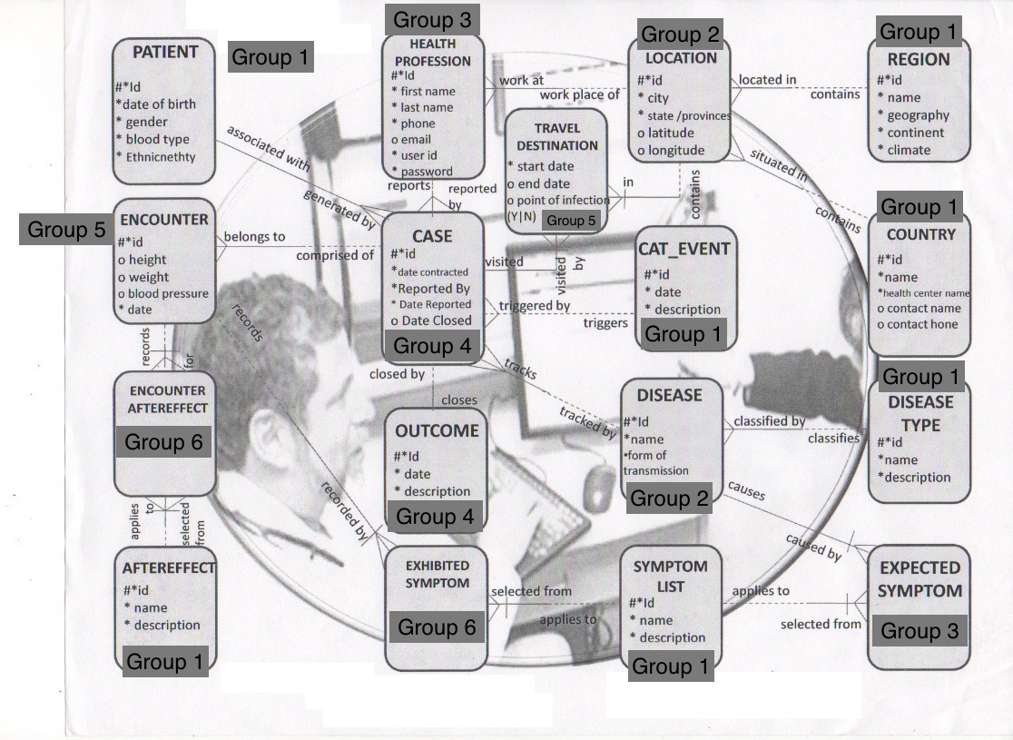
Notes:
The tables with zero foreign keys are created first and each group progresses through the tables with the most reliance on previously completed tables. Because both tables in Group 4 rely on each other they were created simultaneously but an alter statement adds one of their foreign keys when the script runs, in order to avoid errors.

Slide 5
Inserting and Indexing Data
Standard SQL insert statements
Indexes on COUNTRY, PATIENT, and CASE tables
B-Tree
Bitmap
Function
CREATE BITMAP INDEX PATIENT_BLOOD_TYPE_IDX
ON PATIENT(BLOOD_TYPE);
INSERT INTO COUNTRY (COUNTRY_ID,NAME, HEALTH_CENTER,CONTACT_NAME) VALUES(COUNTRY_ID_SEQ.NEXTVAL,'AMERICA', 'BATES HOSPITAL','CONSTANCE PETERSEN');
Notes:
A B-Tree index was added to the NAME field in the COUNTRY table because names will be a frequent search term.
A Bitmap index was added to the BLOOD_TYPE field of the PATIENT table because of the limited number of options the field could be.
A function-based index was created on the difference between the DATE_REPORTED and DATE_CONTRACTED in the CASE table because this is an important metric of how quickly diseases are dealt with.
Full list in Appendix C.
Brief examples given in the slide above but the procedure is generic and should be familiar to the DBA.

Slide 6
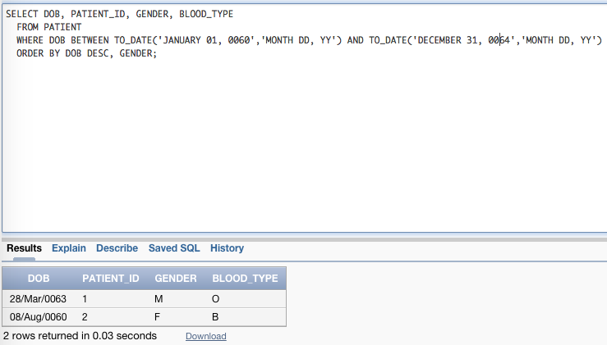
Common Queries
Notes:
There is extensive functionality built into the GDT and can handle complex queries that managers may have to help users troubleshoot. Simpler queries specifically outlined in the database project are in Appendix E.
The following query allows for the search of patients born within a set time period and ordered in descending order by date of birth and then by gender.
Ex:
9A WHERE CLAUSE, 9B BETWEEN AND OPERATOR, 11Dd TO_DATE FUNCTION, 9Ga SECONDARY SORT IN ORDER BY CLAUSE

Slide 7
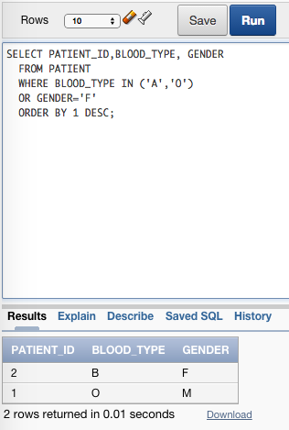
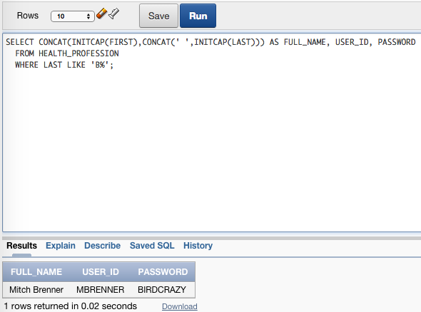
Notes:
These are more brief queries that could be useful and show the flexibility of the database.
The following query will display patients with a blood type of A or O, or that are female. This could be used to quickly narrow down potential blood donors.
9C IN OPERATOR, 9E LOGICAL OPERATORS, 9Gb ORDER BY SELECT ORDER
The following query display the full name, user id, and password of a health professional whose last name starts with B. This could come in handy when recovering passwords for doctors who are so tired they can only remember their last names.
9D LIKE OPERATORS, 11Ac INITCAP CASE CONVERSION,11Bh CONCAT FUNCTION

Slide 8
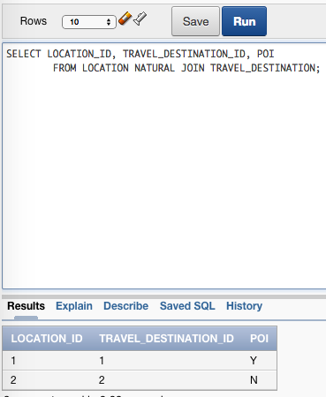
Table Joins
Easy table joins because of simple ERD
Notes:
This one shows the location of patient, their travel destinations, and whether these destinations are points of interest.
10B EQUALITY JOINS

Slide 9
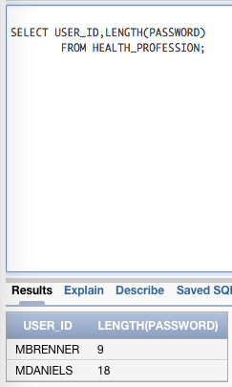
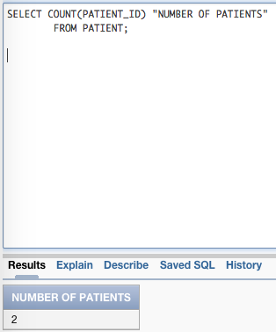
Single Row and Group Functions
Notes:
Single row functions can be used to manipulate the formatting of data returned by queries or quickly do calculations on information in the columns.

Slide 10
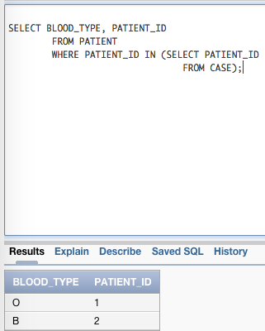
Sub-queries
Single row
Multiple row
Notes:
Sub-queries enable the ability to cross-reference all patients and their blood types that are in the patient table and display them if they are also in the case table. Not all patients might have had a case file opened so this quickly narrows down that data.
Users may require more varied methods.

Slide 11
Appendices
A: Table Constraints
B: Sequences and Their Associated Columns
C: Table Indices
D: Table Descriptions
E: Common Simple Queries
F: Full Database Creation Script and All Reference Queries
Notes:
The appendices offer a wealth of information and a method to quickly lookup information vital to statement creation without having to refer to the creation script. D in particular is extremely handy because it lists the field names, column type, constraint type, and to which tables primary keys are being relied upon as foreign keys in other tables.
Appendix E lists the select statements listed in the project outline that were not given number or letter designations but would be very handy to the users.
Appendix F is the entire database creation script and every select statement discussed in the reference manual along with the sections of the project they meet. This appendix has been left in SQL text format for easy copy and pasting without loss of the illuminating comments.

Slide 12
Group | Table name | Fields | Type | Constraints | Foreign key to which table(s)
1 | PATIENT | PATIENT_ID | NUMBER | PRIMARY KEY | CASE
 |  | DOB | DATE | NOT NULL
 |  | GENDER | CHAR | CHECK ‘M’, ‘F’
 |  | BLOOD_TYPE | VARCHAR2 | NOT NULL
 |  | ETHNICITY | VARCHAR2 | NOT NULL
1 | REGION | REGION_ID | NUMBER | PRIMARY KEY | LOCATION
 |  | NAME | VARCHAR2 | UNIQUE, NOT NULL
 |  | GEOGRAPHY | VARCHAR2 | NOT NULL
 |  | CONTINENT | VARCHAR2 | NOT NULL
 |  | CLIMATE | VARCHAR2 | NOT NULL
1 | COUNTRY | COUNTRY_ID | NUMBER | PRIMARY KEY | LOCATION
Notes:
This is a brief look at Appendix D and the type of information it provides

Slide 13
Conclusion
The GDT is a great resource for doctors
Lots of options for customization and creation of new indexes or tables
With the reference manual in hand DBAs should be able to handle any challenge

Slide 14
Works Cited
http://blogs.scientificamerican.com/media/inline/blog/Image/03-13-global-surveillance.jpg
https://dataddict.files.wordpress.com/2013/03/databases.jpg
https://mycourses.qcc.edu/bbcswebdav/pid-1261508-dt-content-rid-1269115_1/courses/CIS228_FA14_01/CIS228ClassProjectRequirmentGlobalDiseaseTrackingFall2014.pdf

